Slide 1
Organizing and Accelerating Your Work with Scrum
Jeff & Michelle Bivens

Slide 2
Introductions:
Jeff Bivens
Director of Program Services, Workiva
Michelle Bivens
Executive Director, Crested Butte Wildflower Festival
Introduce Yourself & Organization
How many people are on your “team”?
How do you currently manage your list of to dos?
Notes:
Introduce ourselves briefly; room introductions; explain use of scrum in CBWF and FedRAMP

Slide 3
What is SCRUM?
Process for managing your projects and workload:
Create and manage your “Product Backlog”
Empower your team to assist with the workload
Make your work visible
Meet with the team daily, celebrate success, identify improvements
REPEAT
Short Video

Slide 4
Activity:
Take 5 minutes and create a list of 10 – 15 things you need to do
Can be items you need to accomplish in the next day or next few months
Try to break down large projects into parts
Example: Apply for Community Foundation Grant
Prepare Financials
Gather Required Attachments
Complete Purpose & Community Impact Sections
Complete Governance and Financial Management Sections
Review & Submit Application
Notes:
Find a volunteer willing to create a list in a google doc that can be shared with the group

Slide 5
Product Backlog AKA – To Dos
Everything that needs to be built or done to make the vision/product a reality
Entire team contributes items
Managed by Product Owner
Notes:
Explain the participants have just created their Scurm backlog – the items that need to be done

Slide 6
How to Prioritize Your Backlog:
Importance:
Urgency
1 = Critical
2 = High
3 = Medium
4 = Low
1 = NOW
2 = This week
3 = Next week
4 = Next month
5 = Later
Notes:
Explain the importance of using both metrics; assign values to backlog independently

Slide 7
Activity: Assign values to your Backlog items
Assess
Assess your list and assign a number of importance to each item
Assess
Assess your list and assign a number for urgency to each item
Assign
Assign categories separately – avoid the temptation to do them together
Notes:
As folks are categorizing their lists, perform a sample google doc; 5 – 10 minutes

Slide 8
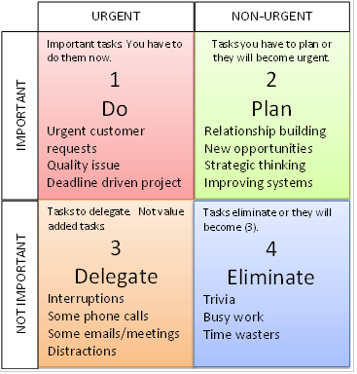
Eisenhower Matrix
Sort your list by importance first; then urgency (demonstration)
This becomes your ordered task list – tackle the top items FIRST!
Notes:
Demonstrate how to sort their list via the google document; Explain how to use the matrix to do the most important work first

Slide 10
Empower Your Team & Set Up Your Sprint
Product Owner:
Owns what is desired and why it is desired. Manages the Backlog. Verifies task completion.
Scrum Master:
Manages process and meetings. Serves the PO, Team, and organization.
Team:
Owns how and how quickly work is delivered. Self-organizing and cross-functional. Creative, productive, and flexible.
Notes:
Explain the SCRUM Roles and how to pick members of the team. Example that Jeff and I are both PO and SM

Slide 11
Sprint Planning Meeting:
Determine the length of your Sprint
Usually 2 – 3 weeks; CBWF used 1 week Sprints May – July 15th
Plan the Sprint (Sprint Planning Meeting)
Product Owner explains the Backlog items and goals for the Sprint
Responsible for Product success; maintains organizational vision
Team assigns owners and level of difficulty to backlog items
Next slide
Team decides how much of the backlog they can accomplish during the Sprint
Once established backlog items cannot change during the Sprint!
Notes:
Discuss how powerful it is to allow the TEAM to assign ownership to the backlog items; Examples of Katie with the press release & Lindsey with the hammers. Explain that in order for this to work the team must be allowed ownership over the process and products

Slide 12
Level of Effort
Assign points to tasks based on the level of effort
Points: 1, 2, 3, 5, 8, 13, 21
We are TERRIBLE at estimating the amount of time a task will take!
If more than 8 consider breaking the task into smaller parts
Notes:
Discuss and show the Backlog for CBWF

Slide 13
Activity
Assign Level of Effort to Your Backlog Items
Assign Owners to Your Backlog Items
Utilize Your TEAM!
Notes:
Continue to have volunteer organization complete this activity on the shared google sheet as a demonstration of the process

Slide 14
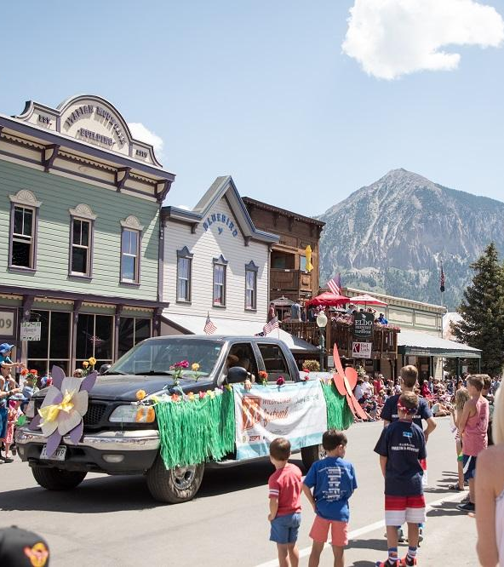
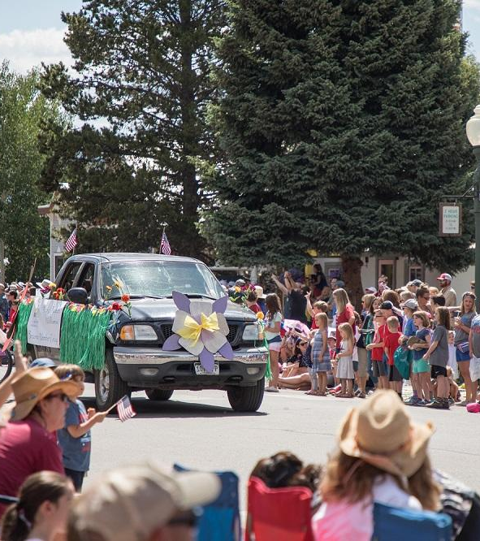
Notes:
Self organizing teams are happier and more productive at work – Happiness is important to all team members – more on this to come. Refer to slide 12 and emphasize again the importance of allowing the TEAM to have ownership over the process and product

Slide 15
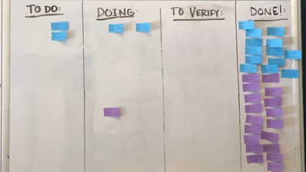
Make Your Work Visible
Scrum Board & Google Doc/Spreadsheet
Keeps track of progress made by entire team on a daily basis
All members can see how entire team is progressing through the Sprint
Notes:
Last Section of the Scrum Process; Visibility also includes the Meetings; Show example of google document with Backlog sorted and owners assigned. Explain how PO determines “Done” Explain how items can get stuck in “To Verify”

Slide 16
Meetings Daily Stand Up
Daily –15 minutes
Three Questions:
What did you accomplish yesterday?
What will you do today to help the team meet the Sprint Goal?
Is there any obstacle blocking you?
Time for the Team to synchronize and plan
Notes:
It’s the Scrum Master’s responsibility to make the obstacles go away; Examples of how teammates helped clear obstacles during the Festival; explain how high functioning teams help each other overcome obstacles

Slide 17
Sprint Review/Demo Celebrate Success!
Team shows off what they have accomplished during the Sprint
Anyone can attend: Invite customers, board members, management
Notes:
Team shows off only what is “Done”. May not be a completed product, but may be part of a product or a feature of a product. Show examples of completed Sprints for the Festival

Slide 18
Sprint Retrospective
Team determines what went right, what could have gone better
Identify improvements to take into the following Sprint
Add to next Sprint’s backlog
Evaluate HAPPINESS
Notes:
To be effective this meeting requires a fair amount of maturity and trust. Not seeking blame, but looking at the process and for ways to make it better. Seek solutions as a team, and have the fortitude to bring up issues that are bothering you. Explain the importance of Happiness and why it is a key component of the Scrum process. Relate it back to the Team and how empowering them improves their happiness

Slide 19
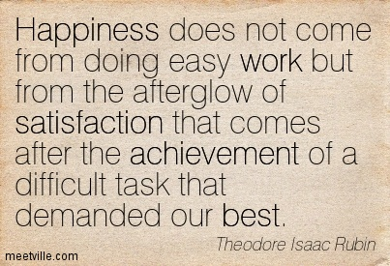

Slide 20
Implement SCRUM
Identify Product Owner – Usually the ED
Organize Your Team
Pick a SCRUM Master
Create and Prioritize a product Backlog
Hold a Sprint Planning Meeting
Make Work Visible – SCRUM Board
Schedule Daily Stand-Up Meetings for Sprint Duration
Invite Guests to Your Sprint Review/Demo
Hold a Sprint Retrospective after the Review
Begin Next Sprint Cycle

