Slide 1
5 Languages of Appreciation in the Workplace
This training comes from Gary Chapman’s book The 5 Languages of Appreciation in the Workplace.

Slide 2
5 Languages of Appreciation
Words of Affirmation
Quality Time
Acts of Service
Tangible Gifts
Physical Touch

Slide 3
Steven Covey, author of
“The 7 Habits of Highly Effective People”
states:
“Next to physical survival, the greatest need of a human being is psychological survival, to be understood, to be affirmed, to be validated, to be appreciated.”

Slide 4
Platinum Rule
For appreciation to truly be effective in must be individualized, personal, genuine and authentic.
Appreciate people in the way that they want to be appreciated. Not in the way that you might want or in the way that is most comfortable for you.

Slide 5

Language #1 –
WORDS OF AFFIRMATION
This is the language that uses words to communicate a
positive message
to another person.
When you speak this language, you are
affirming a positive characteristic
about a person.

Slide 6
Dialects – three different ways of using words to affirm
Praise for Accomplishment
Affirmation for Character
(Focus on the “who” not the “do”)
Affirmation for Personality

Slide 7
Language #2
Quality Time
This is the language that uses giving a person your
undivided attention.
The key element of quality time is
not proximity but personal attention.

Slide 8
Dialects – four different ways of using quality time to affirm
Quality Conversation :
empathetic dialogue – thoughts, feelings, uninterrupted, create a safe environment
maintain eye contact, don’t multitask, listen for feeling as well as thoughts, affirm feelings, observe body language, refuse to interrupt
Shared Experiences:
invited to participate in activities
Small Group Dialogue:
sharing ideas and suggestions
Working in Close Physical Proximity to Accomplish a Project:
making a difference together and/or contributions valued by others
Who? Where? When?

Slide 9
Acts of Service
This is the language that expresses a sincere desire to help
with a cheerful attitude .
Don’t tell me show me!

Slide 10
Tangible Gifts
This is the language that uses giving a person
a tangible gift/reward.
(not necessarily monetary)

Slide 11
Most effective when the gift shows that the giver has spent time and energy thinking about the gift.
Be sure the gift is something that will actually be valued by the receiver.
Giving a gift to someone who doesn’t really appreciate gifts has little impact or some time can create an offense.
Time off or gift cards can be effective

Slide 12
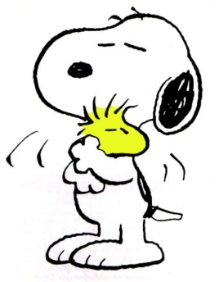
Physical Touch
This is the language, when appropriately used, that can demonstrate:
a sense of trust
connectedness
affirmation
and caring
What does appropriate physical touch look like in your work setting?

Slide 13
Blind spot: a language we don’t speak – something we don’t know we don’t know.
We don’t value this language. Assume others don’t either
Work hard but people still don’t feel appreciated. “It doesn’t count”

